Slide 1
Thermodynamics Lecture 01
Basic Mechanical Engineering

Slide 2
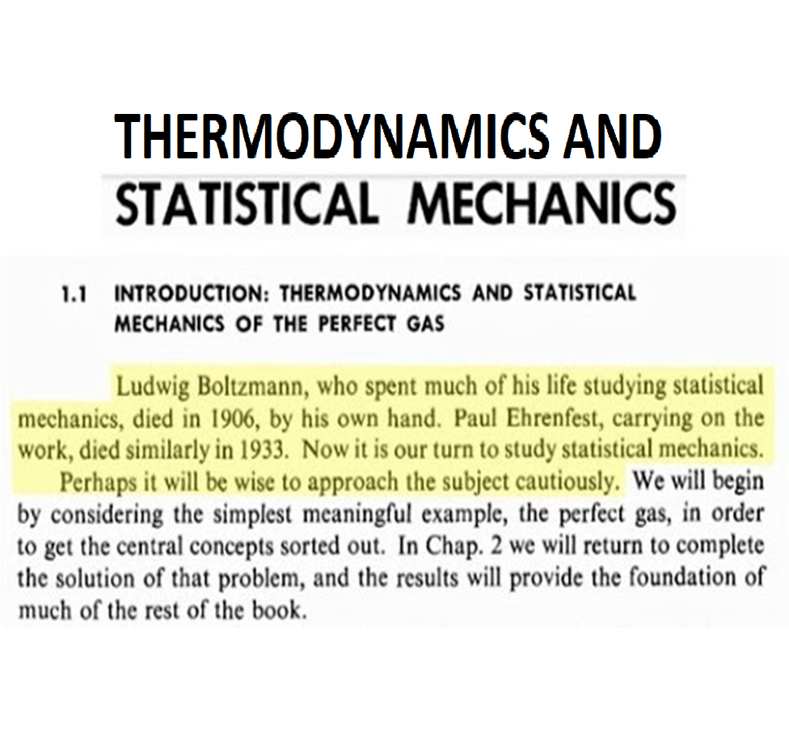

Slide 3
THERMODYNAMICES
THERMO--- Heat Released
DYNAMICS ----- Mechanical Action For doing work
The study of the effects of work, heat flow, and energy on a system
Movement of thermal energy
Engineers use thermodynamics in systems ranging from nuclear power plants to electrical components.
Thermodynamics is the study of the effects of work, heat, and energy on a system
Thermodynamics is only concerned with macroscopic (large- scale) changes and observations

Slide 4
SYSTEM, SURROUNDING ,UNIVERSE
SYSTEM-Area under thermodynamic study
SURROUNDING – Area outside the system
Surface/Layer/Partition
BOUNDARY- | System | & Surrounding | are
separated by | some | Imaginary Or | real
UNIVERSE – System & together is called Universe
Surroundings put

Slide 5

ISOLATED, CLOSED AND OPEN SYSTEMS
4
Isolated System
Neither energy nor mass can be exchanged.
E.g. Thermo flask
Closed System
Energy, but not mass can be exchanged.
E.g. Cylinder filled with gas & piston
Open System
Both energy and mass can be exchanged.
E.g. Gas turbine, I.C. Engine

Slide 6
THERMODYNAMIC PROPERTIES
Thermodynamic Properties – It is measurable & Observable characteristics of the system.
Extensive: Depend on mass/size of system (Volume [V]), Energy
Intensive: Independent of system mass/size (Pressure [P], Temperature [T])
Specific: Extensive/mass (Specific Volume [v])

Slide 7
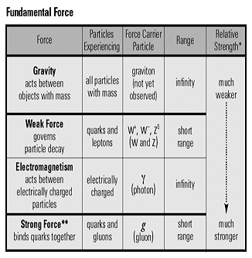
What is Force?
In physics, a force is any interaction that, when unopposed, will change the motion of an object. A force can cause an object with mass to change its velocity (which includes to begin moving from a state of rest), i.e., to accelerate. Force can also be described intuitively as a push or a pull. A force has both magnitude and direction, making it a vector quantity. It is measured in the SI unit of newtons and represented by the symbol F. We know that, F = ma.

Slide 8
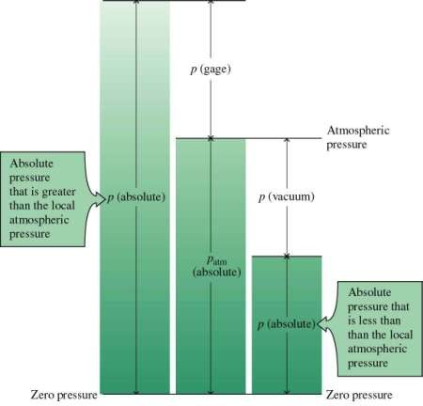
PRESSURE
PRESSURE
PRESSURE
P = Force/Area
Pa, Kpa,Bar, N/m²
Types:
Absolute
Gage (Vacuum)
Atmospheric
^{P}abs ^{=P}atm ^{+/- P}gauge

Slide 9
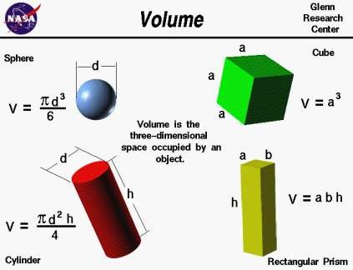
Volume
Volume
Volume
Three dimensional space occupied by an object
Unit- M³ , Liter

Slide 10
What is Energy?
During Newton’s time there was no concept of “energy”. Sir Isaac Newton just gave the world concept of “force”.
In physics, energy (unit “Joule”) is the quantitative property that must be transferred to an object in order to perform work on, or to heat the object.
K.E. = (1/2)mv^2. Concept of velocity square was new at that time.

Slide 11
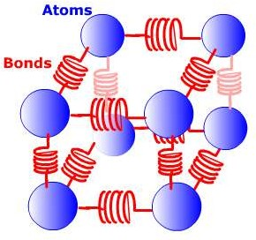
Internal energy
Internal Energy
Internal Energy [U]
Internal energy (also called thermal energy) is the energy an object or substance is due to the kinetic and potential energies associated with the random motions of all the particles that make it up.
Monatomic ideal gas: E_{int} = (3/2)nRT
Diatomic ideal gas: E_{int} = (5/2)nRT
Polyatomic ideal gas: E_{int} = (6/2)nRT

Slide 12
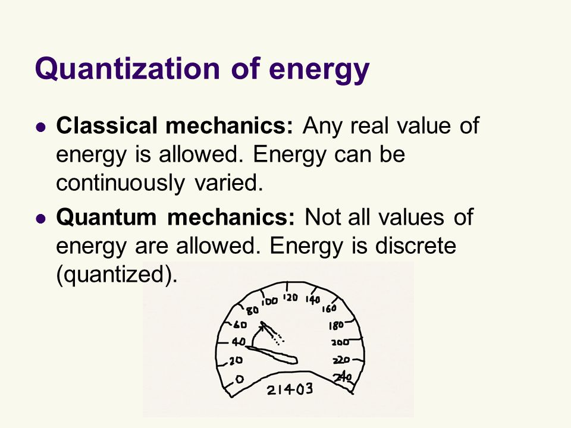

Slide 13
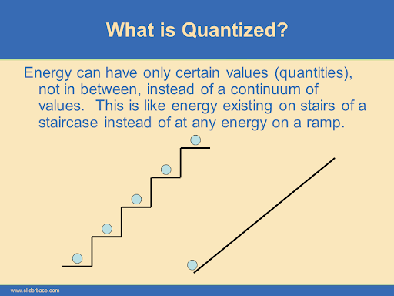

Slide 14
What is Heat?
During Newtonian era heat was considered as to be a substance, if it is available in any matter then it will be warmer. It was called “calor” from which the word calorie came. (Example: if we have more salt in a substance it becomes salty, more sugar makes it sweet and more chili makes it spicy, similarly more calor makes thing warm.
In 1845 James Prescott Joule discovered the link between mechanical work and the generation of heat. Later these developments led to the theory of conservation of energy, formalized largely by William Thomson (A.K.A. Lord Kelvin) as the field of thermodynamics.
Q = (mc)dT + (mL). Here, c = specific heat & L = latent heat.

Slide 15
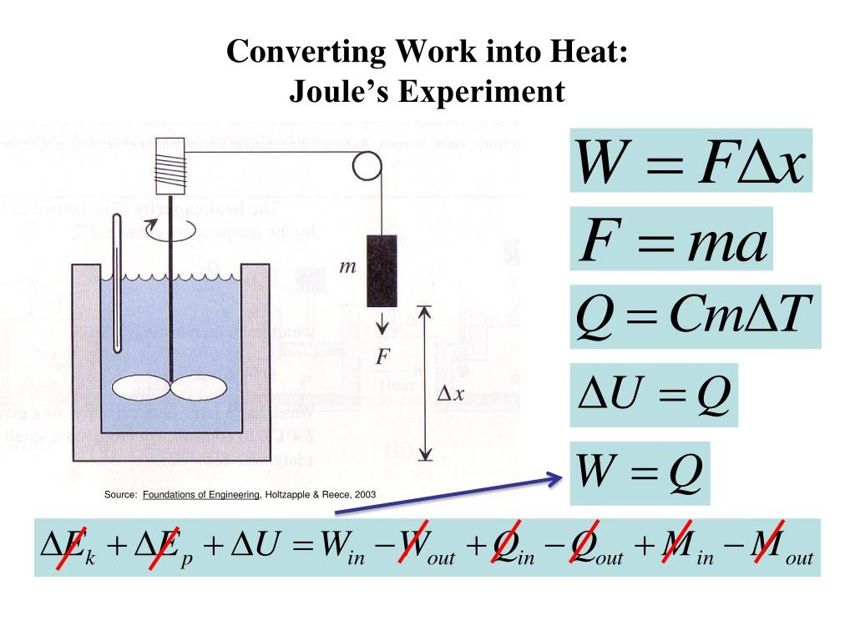
What is Work?
It is also possible to change the temperature of a substance by doing work. Work can do transfer energy into or out of a system. This realization helped establish the fact that is heat is a form of energy. Mr. James Prescott Joule (1818–1889) performed many - many experiments to establish the, ”mechanical equivalent of heat” — the work needed to produce the same effects as heat transfer.
Concept of Force: F = d(mv)/dt
Concept of Energy: E = ∫ FdS
Do the integration to find velocity squared.

Slide 16
What is Power?
In physics, power is the amount of energy converted or, work done per unit time. In SI, the unit of power is the watt, equal to one joule per second. Power is a scalar quantity. Dimension [L^2][M][T^-3].
P = E/t = W/t = FS/t = F(v)
For Electrical and Electronics Engineers:
P = W/t = (QV)/t = V.(Q/t) = V.I = (RI).I = RI², [P.S. V = volt, not volume]
But we also denote pressure with P, as P = F/A = FS/AS = W/V
So, to avoid confusion from the next slides throughout the course we will denote power by P_{w} and Pressure by P_{r}.

Slide 17
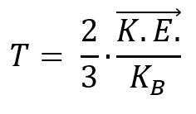
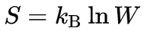
What is Temperature?
Temperature is a physical property of matter that quantitatively expresses hot and cold.
Absolute zero temperature: – 273°C = – 460°F = Zero Kelvin
Kinetic interpretation of Temperature:
Formulas:
Where, k_{B} is the Boltzmann constant and equal to 1.38065 × 10⁻²³ J/K.
Also: . Here, S = Entropy and, W = Work Done.
As temperature flows from high temp. to low temp. So, dS≥0.

Slide 18
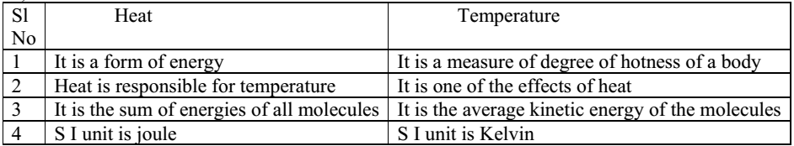
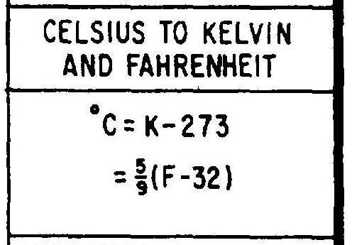
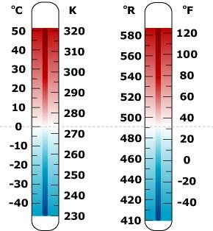
Temperature
Q
m c Δt

Slide 19
What is Entropy?
What is happiness? How can we measure happiness? If you donate a $100 note to a beggar and, a $100 note to a billionaire then who will become happier? Why? Can we measure change in happiness?
The change in happiness between poor beggar and wealthy billionaire can be measured by difference in existing amount of money (+ or -) & divided by existing amount of money. Similarly:
Formula: dS = dQ/T , [where, dS is change in entropy ≥ 0].

Slide 20
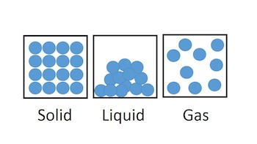
What is Entropy?
Entropy is defined as the non-work producing form of energy. So, it is also regarded as the energy that is not available for performing useful work within a certain environment.
Entropy is a measure of irreversibility or disorder or randomness of a system. An ordered system has low entropy. A disordered system has high entropy.

Slide 21
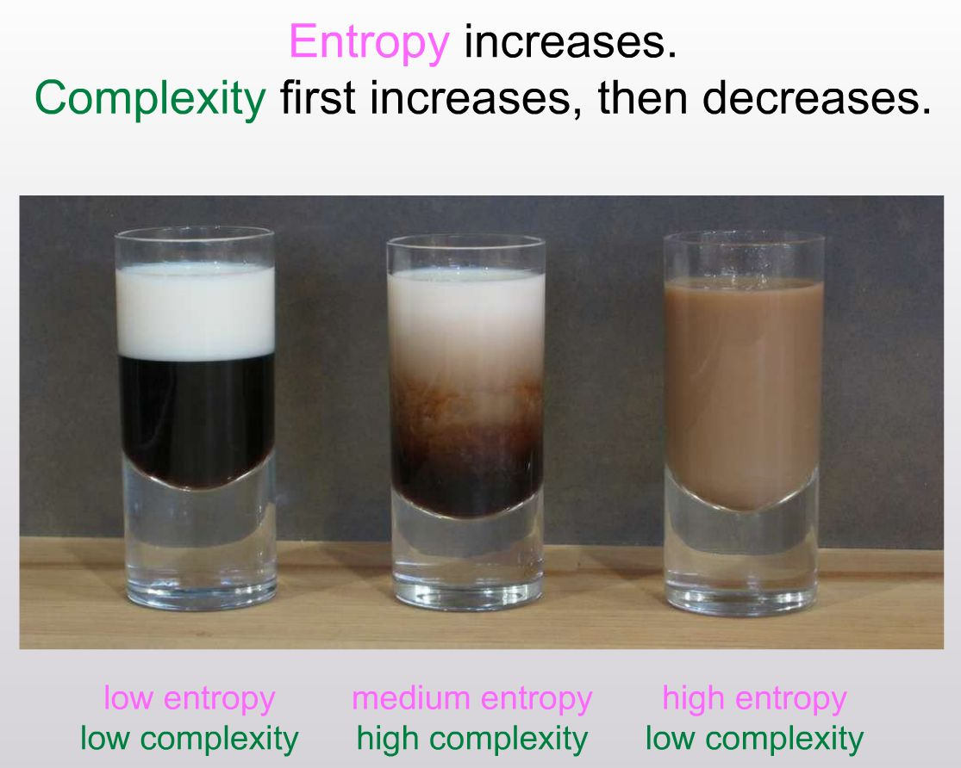
Entropy as Disorder (Milk and Coffee):

Slide 22
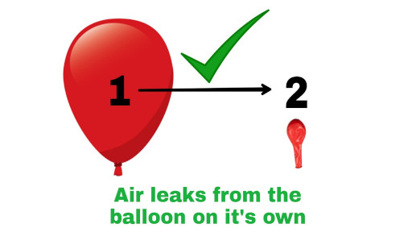
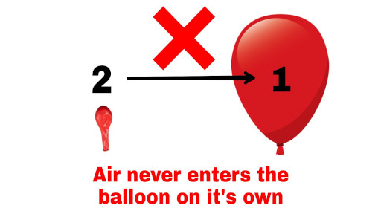
Entropy as Chaos:

Slide 23
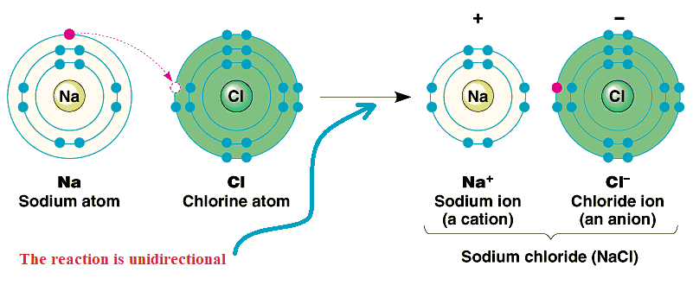
Entropy as irreversibility:

Slide 24
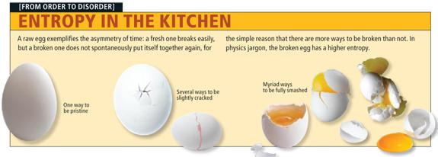
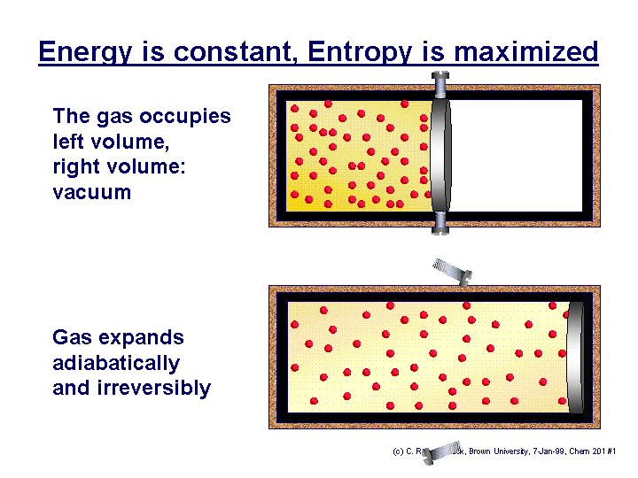
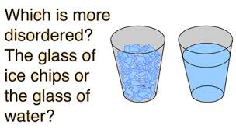
Entropy as Information:

Slide 25

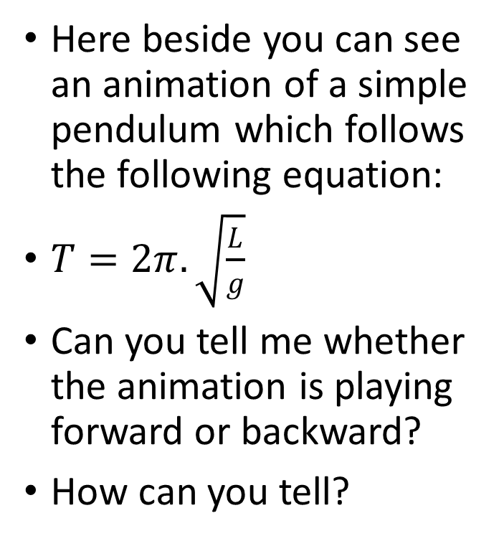
Entropy as Arrow of Time:
Here beside you can see an animation of a simple pendulum which follows the following equation:
$T=2π.\sqrt{\frac{L}{g}}$
Can you tell me whether the animation is playing forward or backward?
How can you tell?

Slide 26
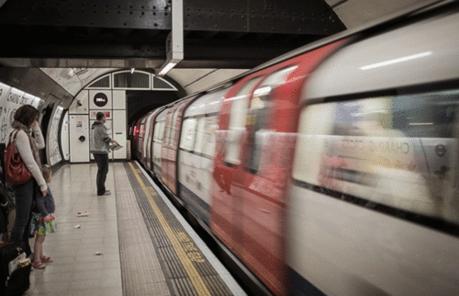
Which way the train is moving?

Slide 27
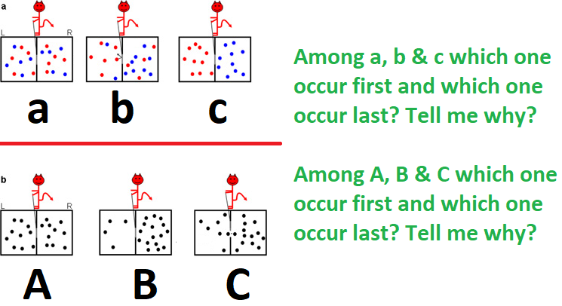

Slide 28
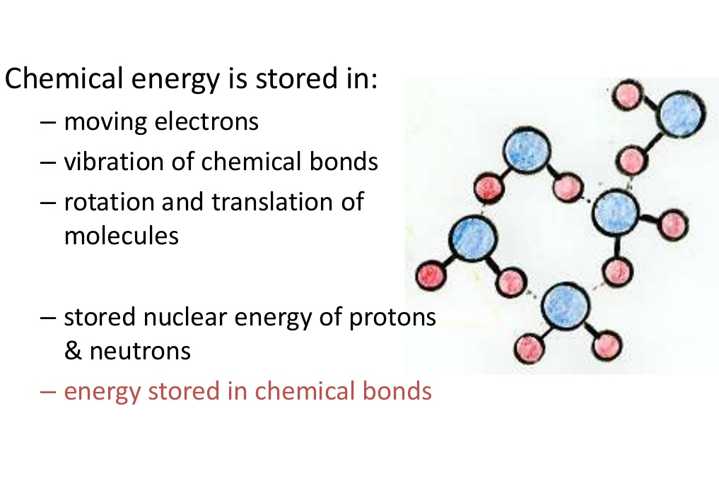
What is Enthalpy?

Slide 29
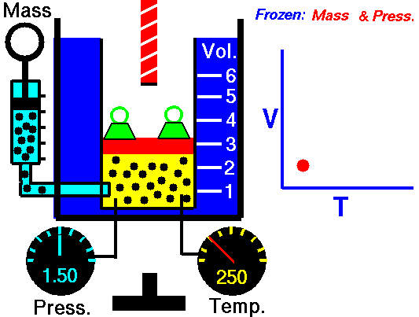
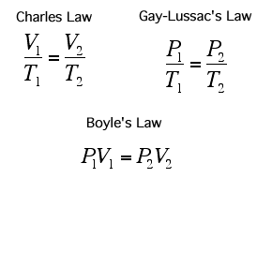
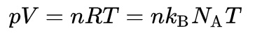
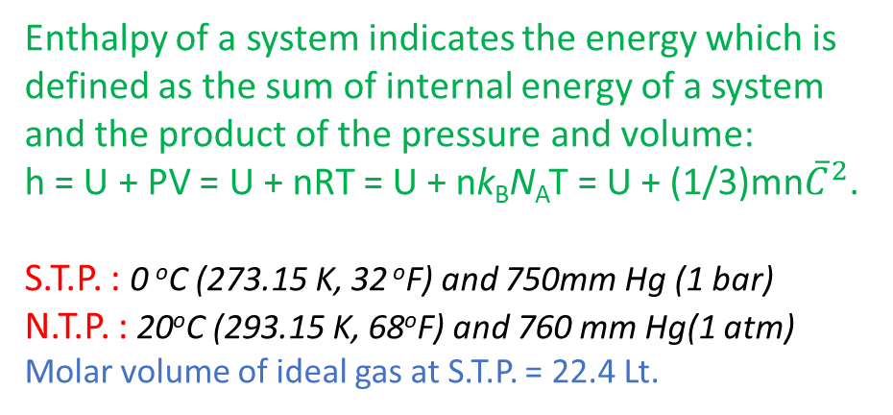
What is Enthalpy?
Enthalpy of a system indicates the energy which is defined as the sum of internal energy of a system and the product of the pressure and volume:
h = U + PV = U + nRT = U + nk_{B}N_{A}T = U + (1/3)mn${\overline{C}}^{2}$.
S.T.P. : 0 ºC (273.15 K, 32 ºF) and 750mm Hg (1 bar)
N.T.P. : 20ºC (293.15 K, 68ºF) and 760 mm Hg(1 atm)
Molar volume of ideal gas at S.T.P. = 22.4 Lt.

Slide 30
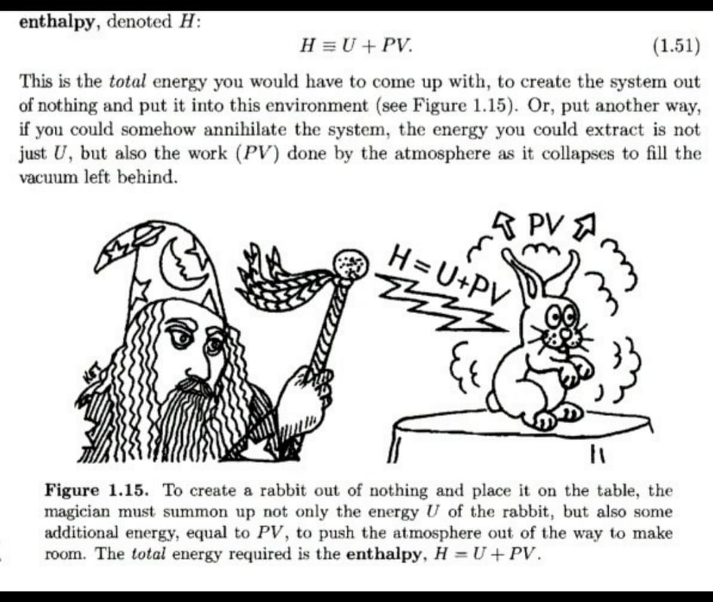
What is Enthalpy?

Slide 31
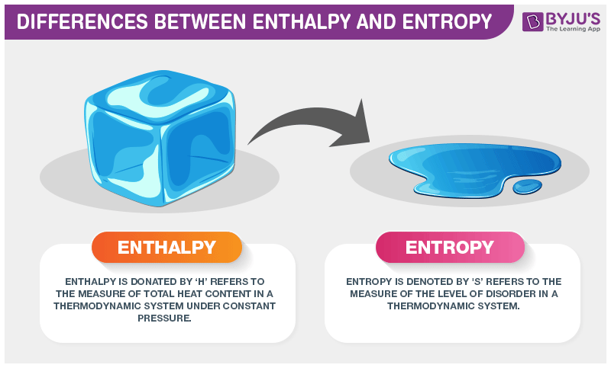
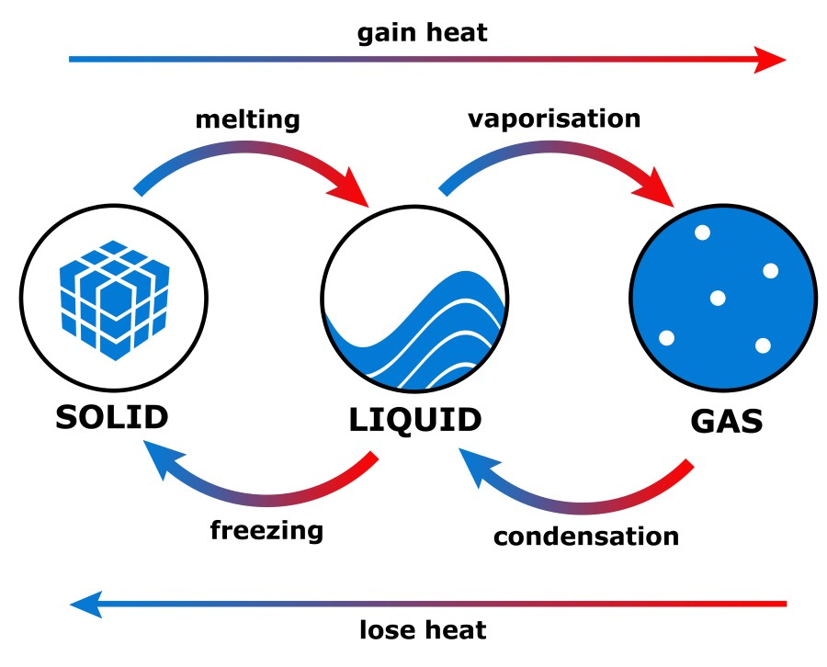
What is Enthalpy?

Slide 32
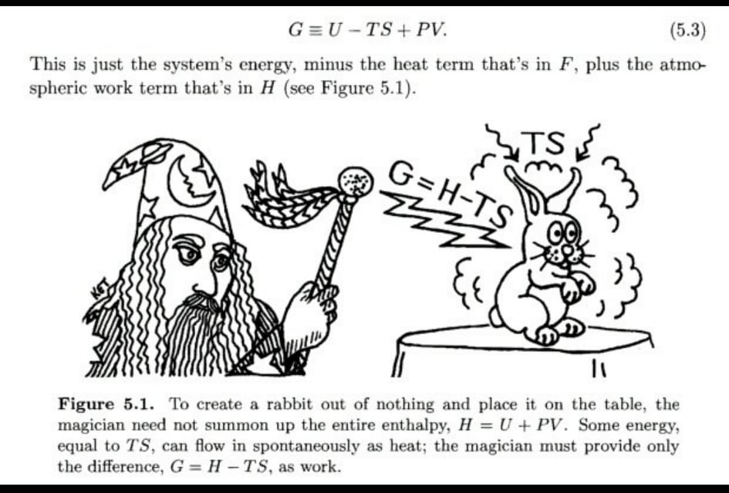
What is Enthalpy?

Slide 33
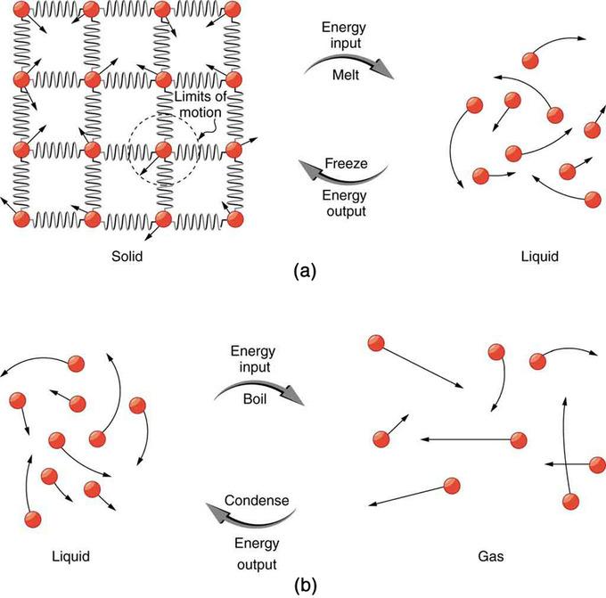
Thermodynamic Systems:
Isobaric: P constant
Isochoric: V constant
Isothermal: T constant
Isentropic: S constant
Isenthalpic: h constant
Adiabatic System: ???
C_{p} - C_{v} = R and γ = C_{p}/C_{v}
Monatomic ideal gas: γ = 1.6666666
Diatomic ideal gas: γ = 1.4
Polyatomic ideal gas: γ = 1.3333333

Slide 34
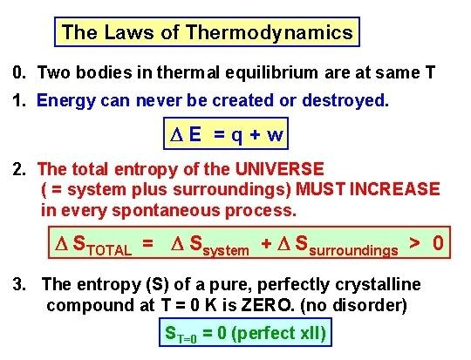
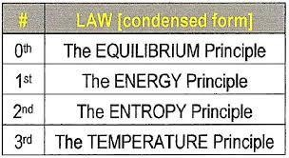
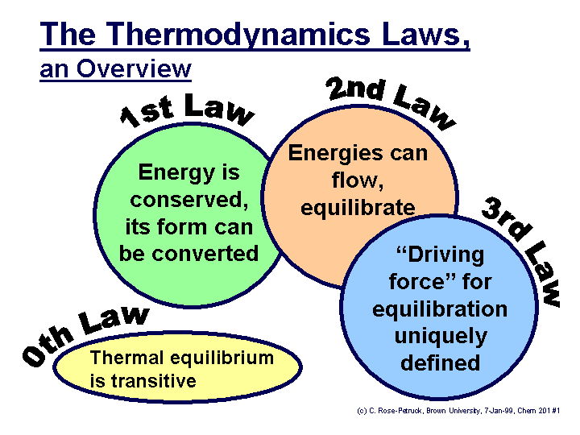
Laws of Thermodynamics:
BME lecture final ter
m week:1

Slide 35
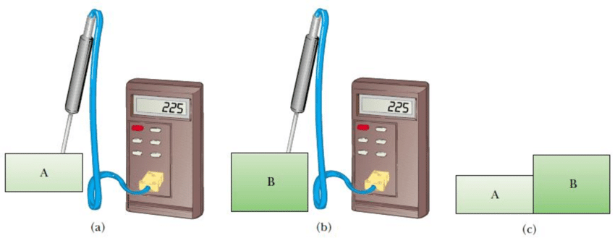
Zeroth Law of Thermodynamics

Slide 36
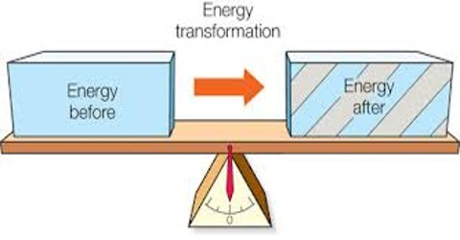
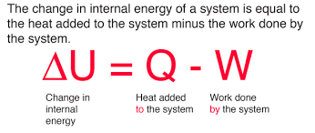
First Law of Thermodynamics

Slide 37
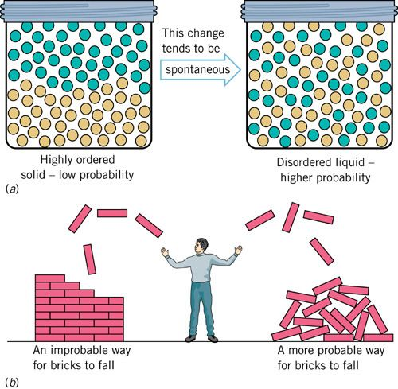
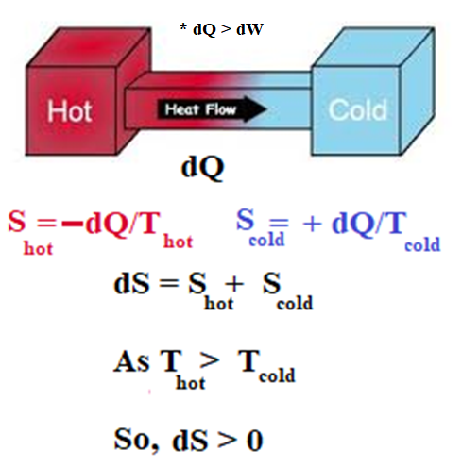
Second Law of Thermodynamics

Slide 38
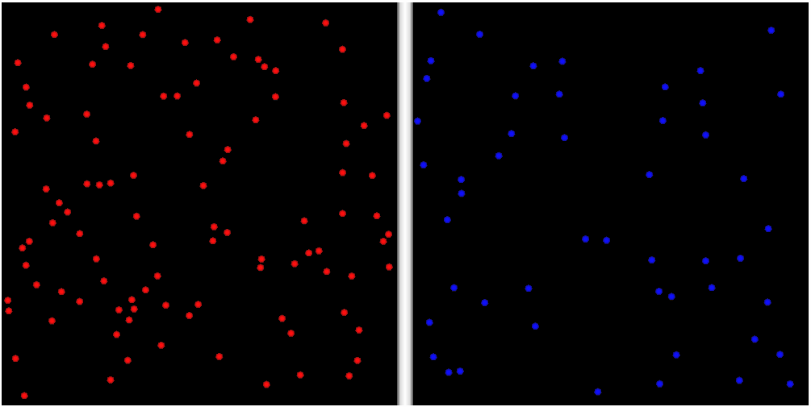
Explain why this happens:
Remember the train animation shown earlier? Is it possible to happen that a tennis ball is resting at ground and suddenly it start to shake and bounce on its own up and down? Or are you playing the video reverse?

Slide 39
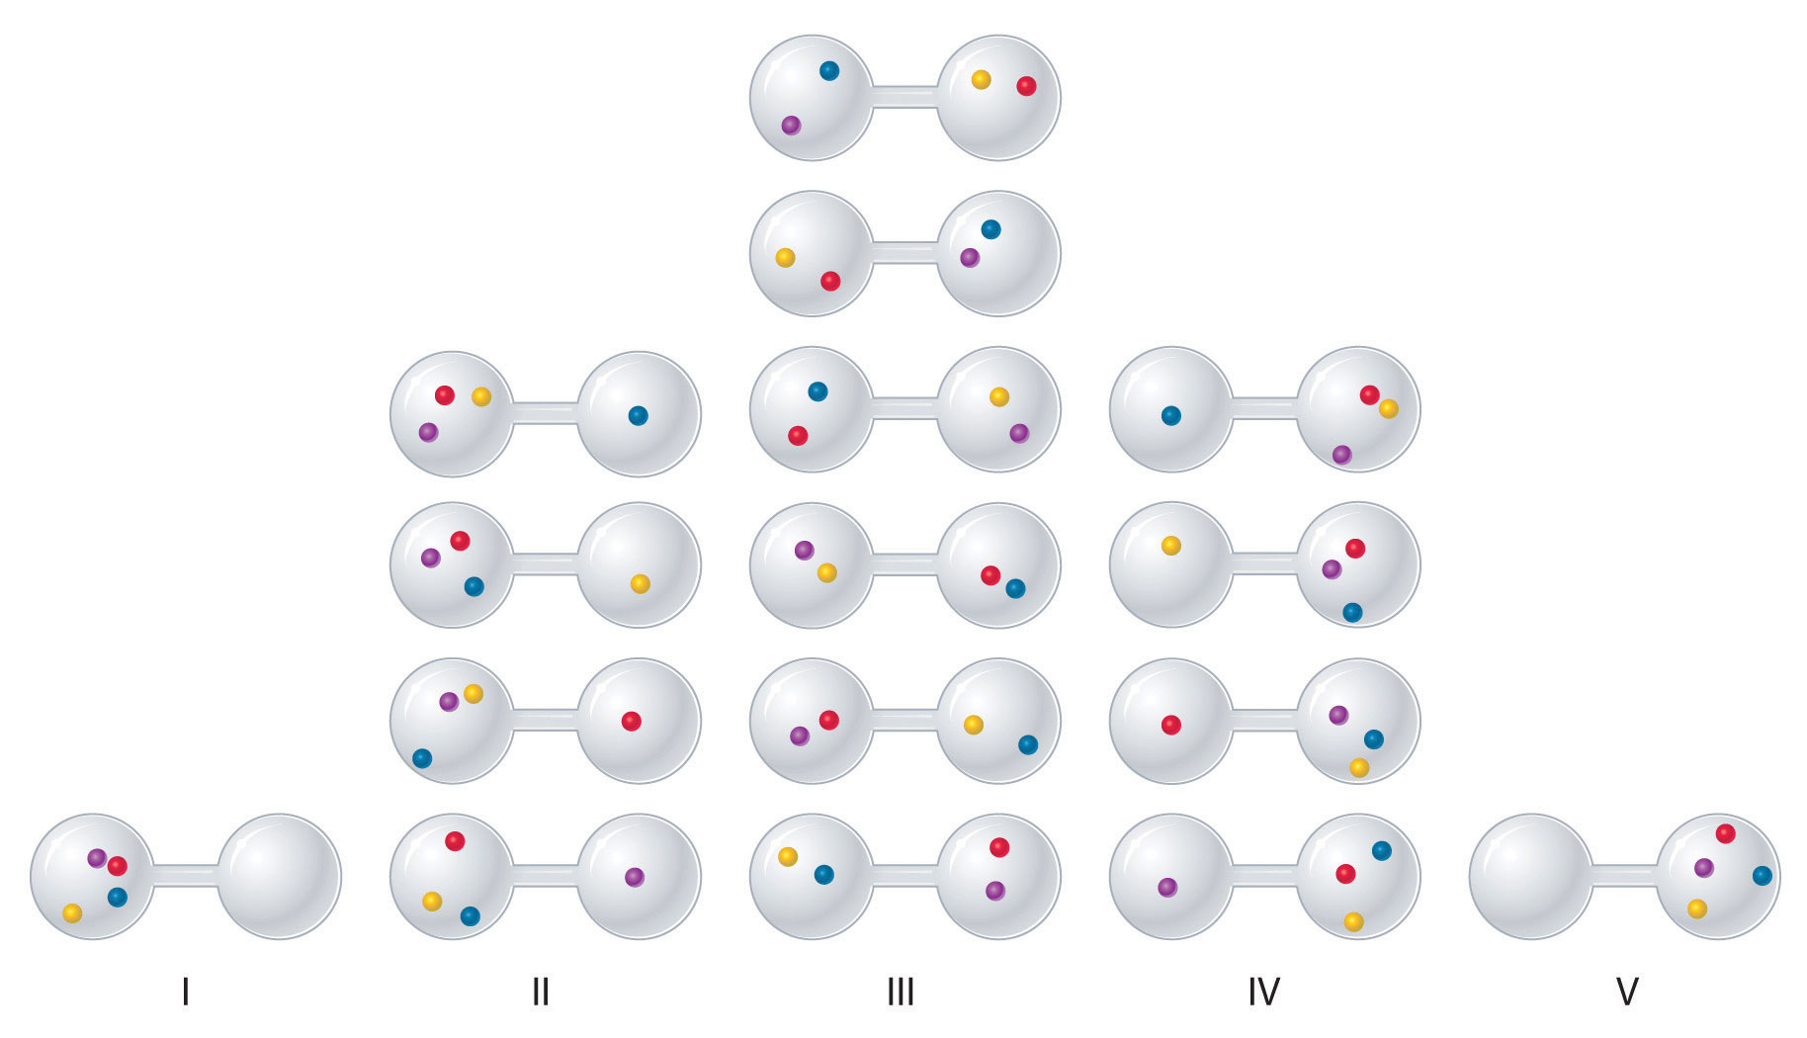
Micro-State vs. Macro-State

Slide 40
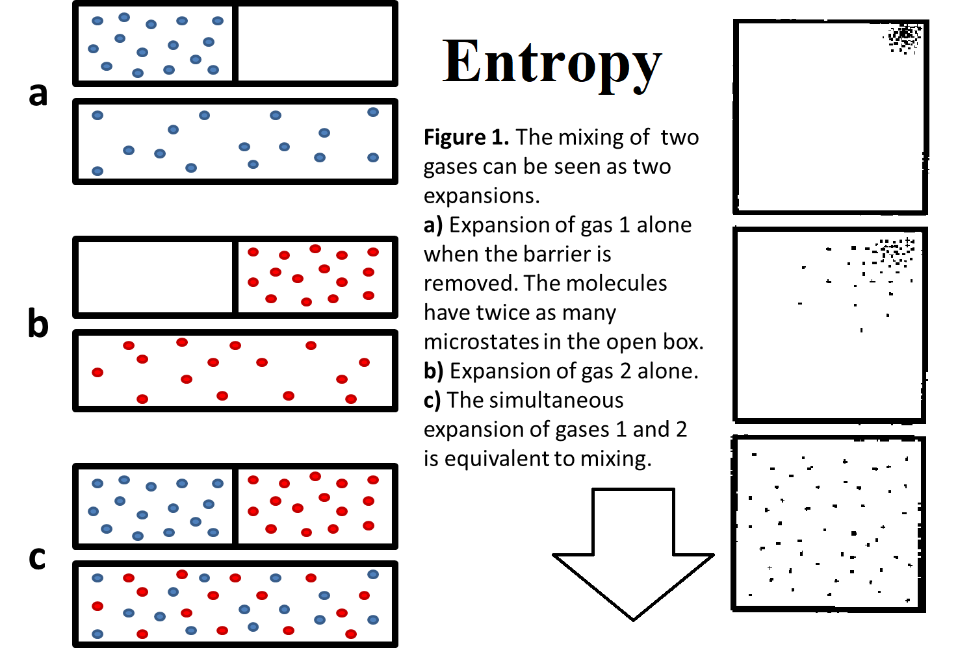
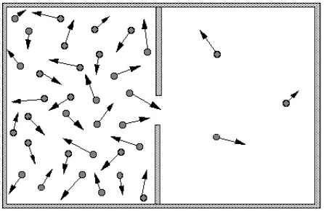
Probability

Slide 41
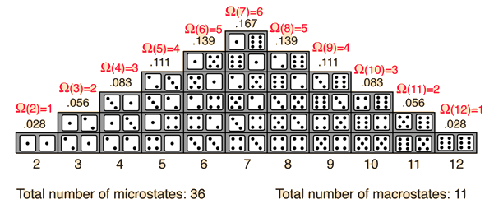

Slide 42
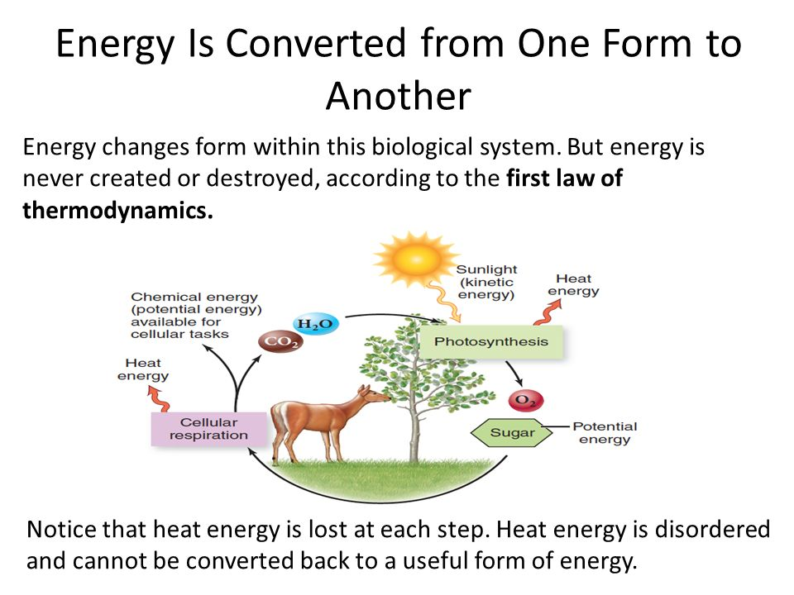
All Energy Transmission is Inefficient:

Slide 43
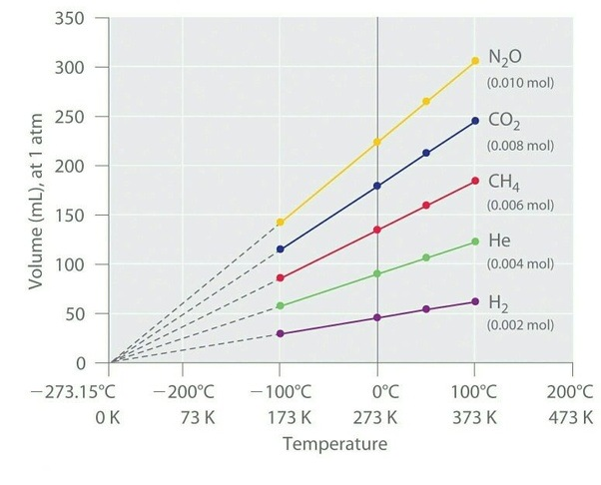
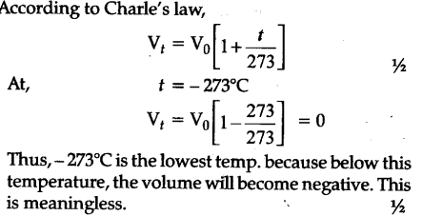
Third Law of Thermodynamics

Slide 44

Third Law of Thermodynamics

Slide 45


Slide 46

Question: Calculate the change in entropy to convert 1kg of 0ºC ice into 100ºC steam at 1 atm pressure.
https://rashidedu.files.wordpress.com/2016/05/1-thermodynamics.pdf
Solution:
Change in entropy to convert 0ºC ice into 0ºC water:
$$dS_{1}= \frac{dQ}{T}=\frac{mL_{f}}{T}= \frac{1 kg. 336 kJ/kg }{273 K}=1.23077 kJ/K$$
Change in entropy to convert 0ºC water into 100ºC water:
$$dS_{2}= \int_{T_{1}}^{T_{2}}{\frac{dQ}{T}}= \int_{273}^{373}{\frac{mcdT}{T}}=mc\left[\ln\left(373\right)−ln⁡(273)\right]=1.\left(4.2\right).ln\left[\frac{373}{273}\right]= 1.31085 kJ/K$$
Change in entropy to convert 100ºC water into 100ºC steam:
$$dS_{3}= \frac{dQ}{T}=\frac{mL_{v}}{T}= \frac{1 kg. 2257 kJ/kg }{373 K}=6.05094 kJ/K$$
Total change in entropy = 8.6 kJ/kg

Slide 47

Entropy and the Clausius Inequality
The second law of thermodynamics leads to the definition of a new property called entropy, a quantitative measure of microscopic disorder for a system. Entropy is a measure of energy that is no longer available to perform useful work within the current environment. To obtain the working definition of entropy and, thus, the second law, let's derive the Clausius inequality.
Consider a heat reservoir giving up heat to a reversible heat engine, which in turn gives up heat to a piston-cylinder device as shown below.

Slide 48
We apply the first law on an incremental basis to the combined system composed of the heat engine and the system.
E_{in} − E_{out} = ΔE_{c}
δQ_{R} − (δW_{rev} + δW_{sys} ) = dE_{c}
where E_{c} is the energy of the combined system. Let W_{c} be the work done by the combined system. Then the first law becomes
δW_{c} = δW_{rev} + δW_{sys}
δQ_{R} − δW_{c} = dE_{c}
If we assume that the engine is totally reversible, then
δQ_{R =} δQ T_{R} T
_{= T} δQ
δQ
R R
T
The total net work done by the combined system becomes
δW = T ^{δQ} − dE
c R
T
c

Slide 49




Now the total work done is found by taking the cyclic integral of the incremental work.
If the system, as well as the heat engine, is required to undergo a cycle, then
and the total net work becomes
If W_{c} is positive, we have a cyclic device exchanging energy with a single heat reservoir and producing an equivalent amount of work; thus, the Kelvin-Planck statement of the second law is violated. But W_{c} can be zero (no work done) or negative (work is done on the combined system) and not violate the Kelvin-Planck statement of the second law. Therefore, since T_{R} > 0 (absolute temperature), we conclude

Slide 50
Let’s look at a simple irreversible cycle on a p-v diagram with two processes
P
. 2
Let A be irreversible and B be reversible
A
.
1
B
υ

Slide 51


By Clausius Inequality _{∫ T} )_{AB} ≤ 0
Irreversible cycle
δQ
Evaluate cyclic integral
δQ ⎞ ² δQ ⎞
² δQ ⎞
∫ _{T} ⎟
= _{∫ T} ⎟
− _{∫ T} ⎟
≤ 0
⎠cycle
⎠_{A}
⎠_{B}
1
1
(non-rev)
(rev)

Slide 52

Irreversible cycle
For the reversible process, B, dS=δQ/dT, thus:
2
= _{∫ T} ⎟ − ∫ dS ≤ 0
δQ ⎞ ² δQ ⎞
∫ _{T} ⎟
⎠cycle
⎠_{A}
1 1
Rearranging and integrating dS:
² δQ ⎞
ΔS ≥ _{∫ T} ⎟
⎠_{A}
1

Slide 53
Second Law of Thermodynamics
² δQ ⎞
ΔS = S₂ − S₁ ≥ _{∫ T} ⎟
⎠_{A}
1
This can be viewed as a mathematical statement of the second law (for a closed system).
Entropy is a non-conserved property!

Slide 54
² δQ ⎞
We can write entropy change as an equality by adding a new term:
∫ _{T} ⎟
S₂ − S₁ =
entropy change
+
^{S}gen
⎠_{A}
1
entropy transfer due to heat transfer
entropy production or generation

Slide 55
Entropy generation
S_{gen} > 0 is an actual irreversible process.
S_{gen} = 0 is a reversible process.
S_{gen} < 0 is an impossible process.

Slide 56
Entropy transfer and production
What if heat were transferred from the system?
The entropy can actually decrease if
² δQ ⎞
∫ _{T} ⎟
^{> S}gen
⎠_{A}
1
and heat is being transferred away
from the system so that Q is negative.

Slide 57
Entropy Production
^{S}gen
quantifies irreversibilities. The
larger the irreversibilities, the greater the value of the entropy production, S_{gen}
.
A reversible process will have no entropy production.

Slide 58
Entropy transfer and production
² δQ ⎞
> 0, Q could be + or –; if –, ∫ _{T} ⎟
^{< S}gen
⎠_{A}
1
S₂ – S₁
because S_{gen} is always positive.
² δQ ⎞
< 0, if Q is negative and
∫ _{T} ⎟
^{> S}gen
⎠_{A}
1
= 0 if Q = 0 and S_{gen} = 0.
² δQ ⎞
∫ _{T} ⎟
= 0 if Q is negative and
^{= S}gen
⎠_{A}
1

Slide 59
Isentropic processes
Note that a reversible (S_{gen} = 0), adiabatic (Q = 0) process is always isentropic (S₁ = S₂)
But, if the process is merely isentropic with S₁ = S₂, it may not be a reversible adiabatic process.
² δQ ⎞
∫ _{T} ⎟
For example, if Q < 0 and
^{= S}gen
⎠_{A}
1

Slide 60
Entropy generation
Consider
S₂ − S₁ =
² δQ ⎞
∫ _{T} ⎟
+
^{S}gen
⎠_{A}
1
What if we draw our system boundaries so large that we encompass all heat transfer interactions? We would thereby isolate the system.

Slide 61
Entropy changes of isolated systems
And then
0
² δQ ⎞
∫ _{T} ⎟
S₂ − S₁ =
+
^{S}gen
⎠_{A}
1
S₂ − S₁
^{= S}gen
But S_{gen}≥0. So, the entropy of an isolated system always increases. (This is the source of the statement, ‘The world is running down.’)
16

Slide 62
Entropy
It is tabulated just like u, v, and h.
Also, s = s_{f}
x(s_{g} − s_{f} )
And, for compressed or subcooled liquids,
s(T, p) ≅ s_{f} (T)

Slide 63

The entropy of a pure substance is determined from the tables, just as for any other property

Slide 64
Ts Diagram for Water

Slide 65
Ts diagrams
Recall that the P-v diagram was very important in first law analysis, and that
w = ∫ pdV
Work was the area under the curve.

Slide 66
For a Ts diagram
Rearrange:
dS = ^{⎛ δQ ⎞}
⎜ _{T} ⎟
⎝
⎠int rev
^{δQ}int rev
^{Q}int rev
Integrate:
= TdS
2
= ∫ TdS
1
If the internally reversible process also is isothermal at some temperature T_{o}:
2
= T_{o ∫} dS = T_{o} ΔS
1
^{Q}int rev
21

Slide 67

On a T-S diagram, the area under the process curve represents the heat transfer for internally reversible processes
d

Slide 68
Entropy change of a thermal reservoir
For a thermal reservoir, heat transfer occurs at constant temperature…the reservoir doesn’t change temperature as heat is removed or added:
ΔS = ∫ ^{δQ}
T
Since T=constant:
ΔS = ^{Q}
T

Slide 69
Derivation of Tds equations:
For a simple closed
system:
dQ – dW = dU
The work is given by:
dW = PdV
Substituting gives:
dQ = dU + PdV

Slide 70
More derivation….
For a reversible process:
TdS = dQ
Make the substitution for δQ in the energy equation:
TdS = dU + PdV
Or on a per unit mass basis:
Tds = du + Pdv

Slide 71
Tds Equations
Entropy is a property. The Tds expression that we just derived expresses entropy in terms of other properties. The properties are independent of path….We can use the Tds equation we just derived to calculate the entropy change between any two states:
Tds = du +Pdv
Starting with enthalpy, it is possible to develop a second Tds equation:
Tds = dh - vdP

Slide 72
Let’s look at the entropy change for an incompressible substance:
We start with the first Tds equation:
Tds = c_{v}(T)dT + Pdv
For incompressible substances, v ≅ const, so dv = 0.
We also know that c_{v}(T) = c(T), so we can write:
c(T)
ds =
dT
T

Slide 73
Entropy change of an incompressible substance
Integrating
^{T2} c(T)
s₂ − s₁ = _{∫ T} dT
T₁
If the specific heat does not vary with temperature:
T
s₂ − s₁ = c ln
2
T
1

Slide 74
Entropy change for an ideal gas
Start with 2nd Tds equation
Tds = dh - vdp
Remember dh and v for an ideal gas?
dh = c_{p}dT And
v=RT/p
Substituting:
Tds = c dT − ^{RT} dp
p
p

Slide 75
Change in entropy for an ideal gas
Dividing through by T,
dT _{− R} dp T p
ds = c
p
Don’t forget, c_{p}=c_{p}(T)…..a function of temperature! Integrating yields
T₂
s₂ − s₁ = ∫ c_{p} (T)
T
dT p
R ln ²
p₁
T
1

Slide 76
Entropy change of an ideal gas for constant specific heats: approximation
Now, if the temperature range is so limited that c_{p} ≅ constant (and c_{v} ≅
constant),
dT T
∫
c
= c ln
2
p
p
T T
T
1
s₂ − s₁ = c_{p} ln
2
R ln ^{p2}
T
p
1
1

Slide 77
Entropy change of an ideal gas for constant specific heats: approximation
Similarly it can be shown from
Tds = du + pdv
that
T
s₂ − s₁ = c_{v} ln
2
R ln ^{v 2}
T
v
1
1

Slide 78
Entropy change of an ideal gas for variable specific heats: exact analysis
Integrating..
T₂
s₂ − s₁ = ∫ c_{p} (T)
dT p
R ln ²
p₁
T
T
1
To evaluate entropy change, we’ll have to evaluate the integral:
T₂
∫ c_{p} T₁
dT
T

Slide 79
Entropy change of an ideal gas for variable specific heats: exact analysis
Evaluation of the integral
T₂
∫ c_{p T} = ∫ c_{p}
T₁
dT
T₂
dT
T₁
∫ c_{p}
dT
T
T
T=0 T=0
= sº (T ) − sº (T )
2 1
And sº(T), the reference entropy, is tabulated in the ideal gas tables for a reference temperature of T = 0 and p = 1
atm.

Slide 80
Entropy change of an ideal gas for variable specific heats: exact analysis
Only ∫ c_{p}dT is tabulated. The ∫ c_{v}dT
is not.
p
o
o
So, s
− s = s (T ) −
s (T ) − R ln
2
2
1
2
1
p
1

Slide 81
Entropy change of an ideal gas
Note that the entropy change of an ideal gas, unlike h and u, is a function of two variables.
Only the reference entropy, sº, is a function of T alone.

Slide 82


Slide 83


Conclusion:

